Slide 1
My New Research Direction:
Question Generation
Copyright © Shenglei Huang 2018.3.6

Slide 2
Contents
Task Definition
Main Sub Tasks
Paper 1 based on sub task 1
Paper 2 based on sub task 2
Conclusion
Copyright © Shenglei Huang 2018.3.6

Slide 3
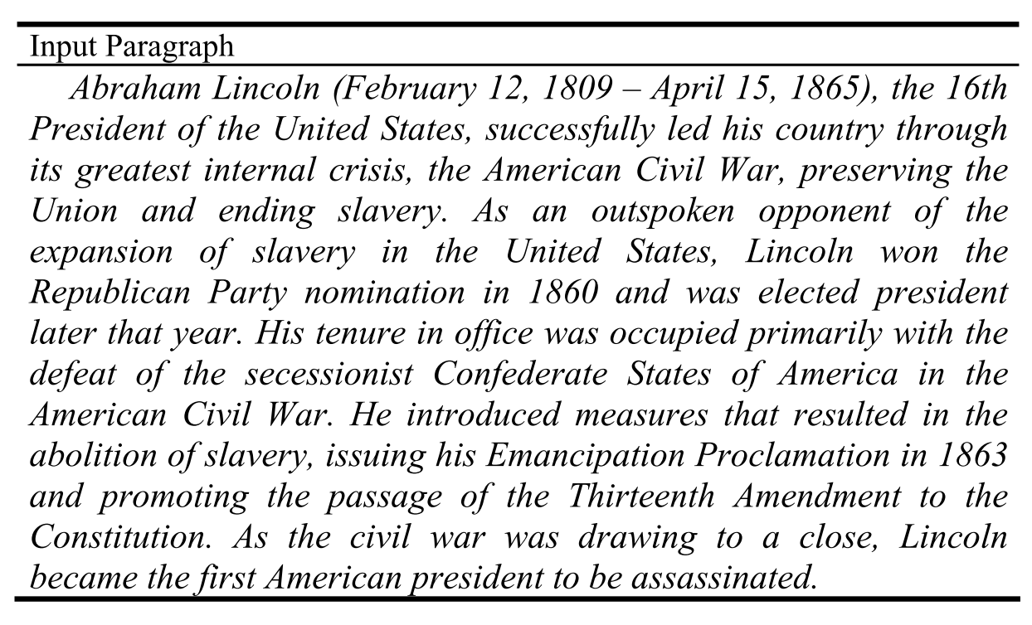
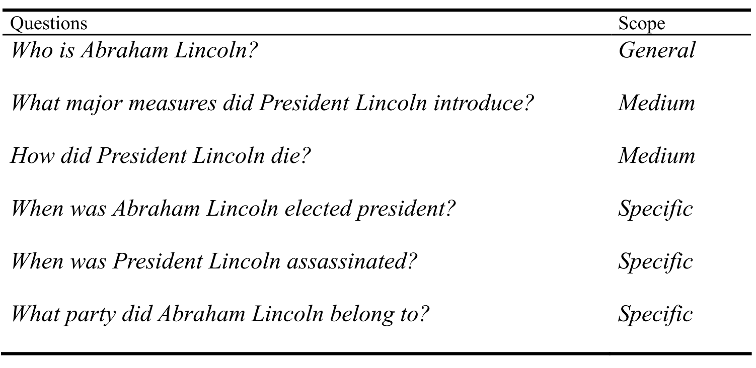
Task Definition(1/5)
Task A: Generate questions from paragraph
Vasile Rus et al. The first question generation shared task evaluation challenge. In Proceedings of the 6th International Natural Language Generation Conference, 2010, page 253.
Copyright © Shenglei Huang 2018.3.6

Slide 4
Task Definition(1/5)
Task B: Generate questions from single sentence
Questions | Type
Who lost his only son in the trenches in 1915? | Who
When did Rudyard Kipling lose his son? | When
How many sons did Rudyard Kipling have? | How many
Input single sentence
The poet Rudyard Kipling lost his only son in the trenches in 1915.
Vasile Rus et al. The first question generation shared task evaluation challenge. In Proceedings of the 6th International Natural Language Generation Conference, 2010, page 255.
Copyright © Shenglei Huang 2018.3.6

Slide 5
Task Definition(1/5)
Step 1
Step 2
Raw Text
Structured Data
Questions
Copyright © Shenglei Huang 2018.3.6

Slide 6
Task Definition(1/5)
Sub task 2
Raw Text
Step 1
Structured Data
Step 2
Questions
Sub task 1
Copyright © Shenglei Huang 2018.3.6

Slide 7
Main Sub Tasks(2/5)
QG Sub tasks:
From structured data (KB triples)
From unstructured data (raw text)
QG Main approaches:
Template based / Rule driven
DL based / Data driven
Copyright © Shenglei Huang 2018.3.6

Slide 8
Main Sub Tasks(2/5)
Today’s papers
1. From structured data (KB triples)
[ACL 2016] Generating Factoid Questions with RNN: The 30M Factoid QA Corpus
2. From unstructured data (raw text)
[ACL 2017] Learning to Ask: Neural Question Generation for Reading Comprehension
Copyright © Shenglei Huang 2018.3.6

Slide 9
Paper 1 based on sub task 1(3/5)
Generating Factoid Questions with RNN:
The 30M Factoid QA Corpus
Iulian Vlad Serban, Alberto Garcia-Duran, Caglar Gulcehre, Sungjin Ahn, Sarath Chandar, Aaron Courville, Yoshua Bengio
ACL 2016
Copyright © Shenglei Huang 2018.3.6

Slide 10


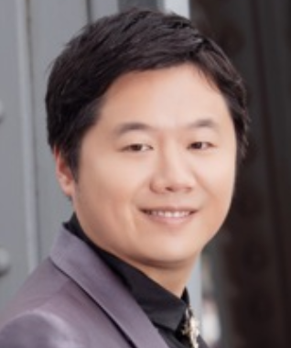

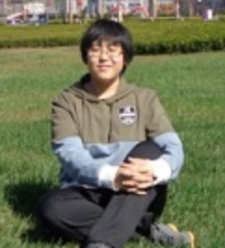


Paper 1 based on sub task 1(3/5)
Structured data: KB triples
supervise
supervise
supervise
supervise
supervise
is schoolmate of
direct
KB Triples: {Shenglei, is schoolmate of , Shanshan}
{Kenny, supervise, Kangqi}
{Kenny, direct, ADAPT}
Copyright © Shenglei Huang 2018.3.6

Slide 11
Paper 1 based on sub task 1(3/5)
Task definition
KB Triples: {fires_creek, contained_by, nantahala_national_forest}
Entity (Subject)
Relationship
Entity (Object)
models
Generated Questions: Which forest is Fires Creek in?
Copyright © Shenglei Huang 2018.3.6

Slide 12
Paper 1 based on sub task 1(3/5)
Motivation
QA systems meet the bottleneck because of the lack of labeled data
Existing synthetic labeled datasets are generated from templated-base and human annotation approaches
Goal
Propose an approach that could automatically generate large and high-quality labeled dataset efficiently
Copyright © Shenglei Huang 2018.3.6

Slide 13
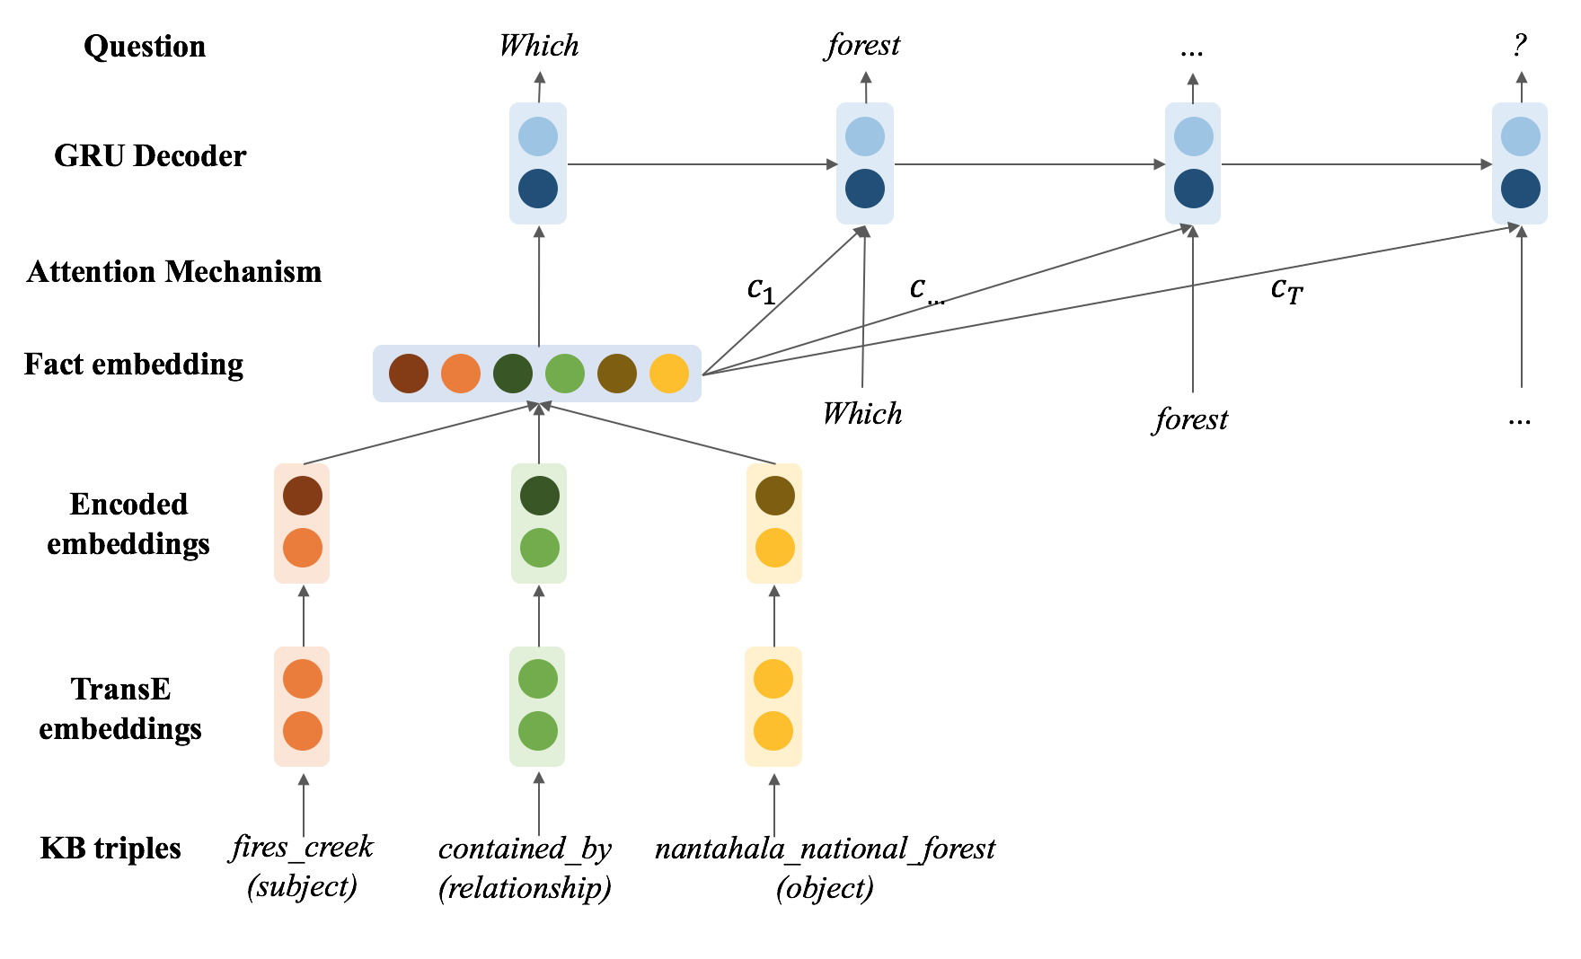
Paper 1 based on sub task 1(3/5)
Model Architecture
Copyright © Shenglei Huang 2018.3.6

Slide 14
Paper 1 based on sub task 1(3/5)
Model Architecture
Copyright © Shenglei Huang 2018.3.6

Slide 15



Paper 1 based on sub task 1(3/5)
TransE
$$e_{s}=E_{in}∙x_{s}$$
$$e_{o}=E_{in}∙x_{o}$$
$$e_{r}=L_{in}∙x_{r}$$
Bordes Antoine et al. Translating Embeddings for Modeling Multi-relational Data. In Advances in Neural Information Processing Systems (NIPS), 2013.
Copyright © Shenglei Huang 2018.3.6

Slide 16



Paper 1 based on sub task 1(3/5)
TransE
$$e_{s}=E_{in}∙x_{s}$$
$$e_{o}=E_{in}∙x_{o}$$
$$e_{r}=L_{in}∙x_{r}$$
Bordes Antoine et al. Translating Embeddings for Modeling Multi-relational Data. In Advances in Neural Information Processing Systems (NIPS), 2013.
Copyright © Shenglei Huang 2018.3.6

Slide 17
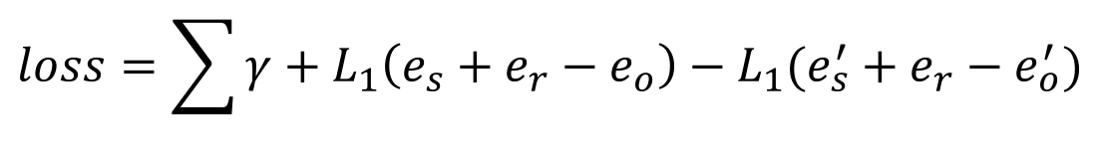
Paper 1 based on sub task 1(3/5)
TransE
$$loss=\sum{γ+L_{1}\left(e_{s}+e_{r}−e_{o}\right)−L_{1}{(e_{s}^{′}+e_{r}−e_{o}^{′})}}$$
Bordes Antoine et al. Translating Embeddings for Modeling Multi-relational Data. In Advances in Neural Information Processing Systems (NIPS), 2013.
Copyright © Shenglei Huang 2018.3.6

Slide 18
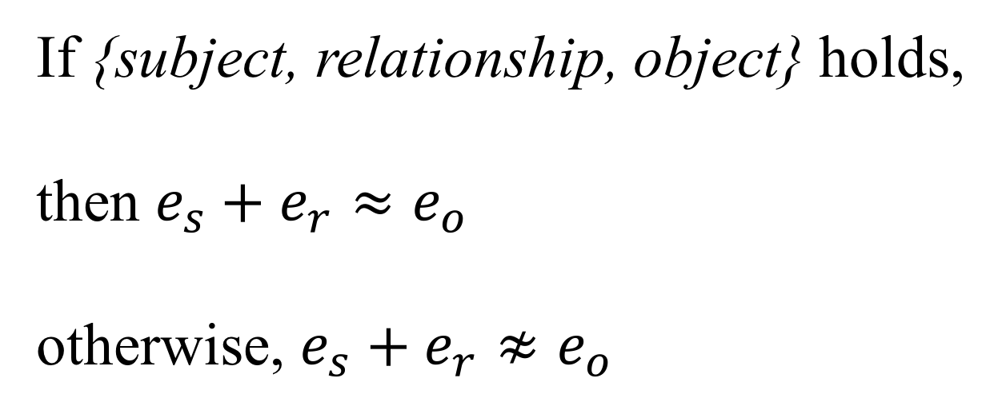
Paper 1 based on sub task 1(3/5)
TransE
If {subject, relationship, object} holds,
then $e_{s}+e_{r}≈e_{o}$
otherwise, $e_{s}+e_{r}≉e_{o}$
Bordes Antoine et al. Translating Embeddings for Modeling Multi-relational Data. In Advances in Neural Information Processing Systems (NIPS), 2013.
Copyright © Shenglei Huang 2018.3.6

Slide 19



Paper 1 based on sub task 1(3/5)
TransE
$$e_{s}=E_{in}∙x_{s}$$
$$e_{o}=E_{in}∙x_{o}$$
$$e_{r}=L_{in}∙x_{r}$$
Bordes Antoine et al. Translating Embeddings for Modeling Multi-relational Data. In Advances in Neural Information Processing Systems (NIPS), 2013.
Copyright © Shenglei Huang 2018.3.6

Slide 20
Paper 1 based on sub task 1(3/5)
Model Architecture
Copyright © Shenglei Huang 2018.3.6

Slide 21
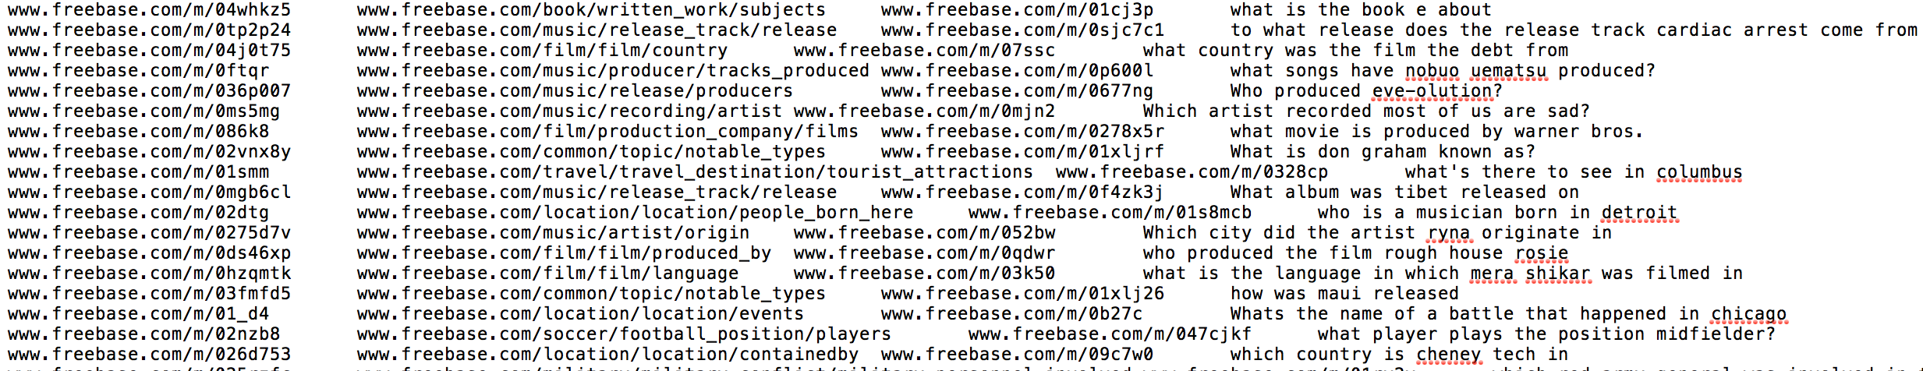
Paper 1 based on sub task 1(3/5)
Training Data
SimpleQuestion:
Paired dataset – (KB triple, question)
Human annotated
Copyright © Shenglei Huang 2018.3.6

Slide 22
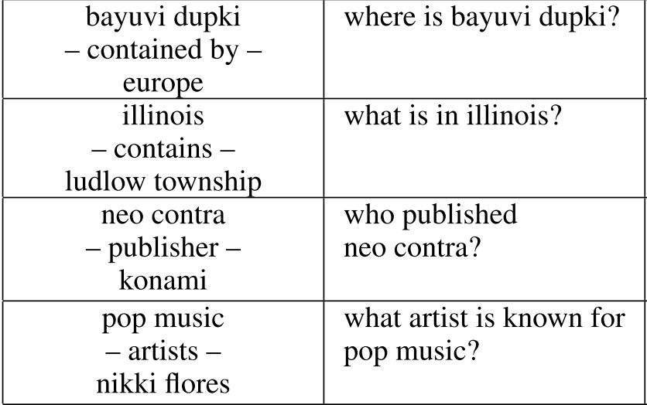
Paper 1 based on sub task 1(3/5)
Training Data
SimpleQuestion:
Paired dataset – (KB triple, question)
Human annotated
Copyright © Shenglei Huang 2018.3.6

Slide 23
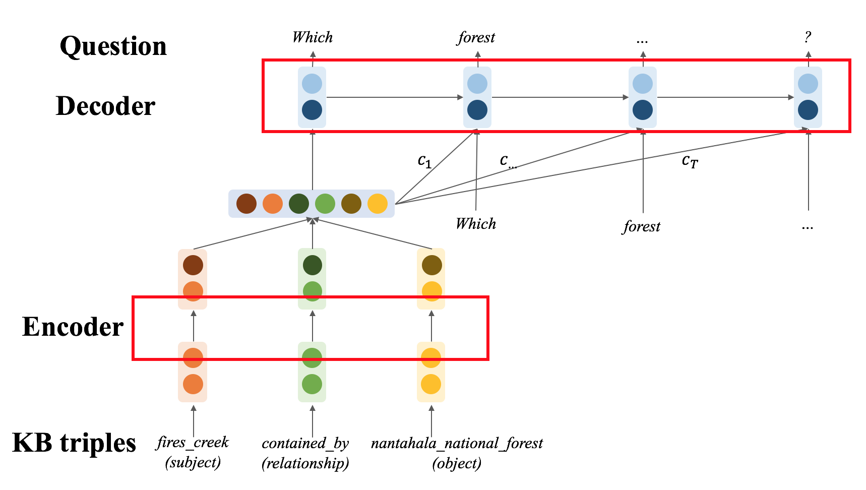
Paper 1 based on sub task 1(3/5)
Seq2Seq Model
Copyright © Shenglei Huang 2018.3.6

Slide 24
Paper 1 based on sub task 1(3/5)
Existing Questions in this naïve seq2seq model
The knowledge graph covered in SimpleQuestion is very sparse
How to deal with unseen subject?
Copyright © Shenglei Huang 2018.3.6

Slide 25
Paper 1 based on sub task 1(3/5)
Deal with sparse KG
Entity A
Entity A
Entity B
Entity B
Dense KG
Sparse KG
Copyright © Shenglei Huang 2018.3.6

Slide 26
Paper 1 based on sub task 1(3/5)
Deal with sparse KG
Expand the dataset for training transE model.
The additional data is extracted from Freebase
The additional data need to be compatible to SimpleQuestion
Could add more relations to the entities in SimpleQuestion
Copyright © Shenglei Huang 2018.3.6

Slide 27
Paper 1 based on sub task 1(3/5)
Deal with sparse KG
Without additional Freebase facts
With additional Freebase facts
Copyright © Shenglei Huang 2018.3.6

Slide 28
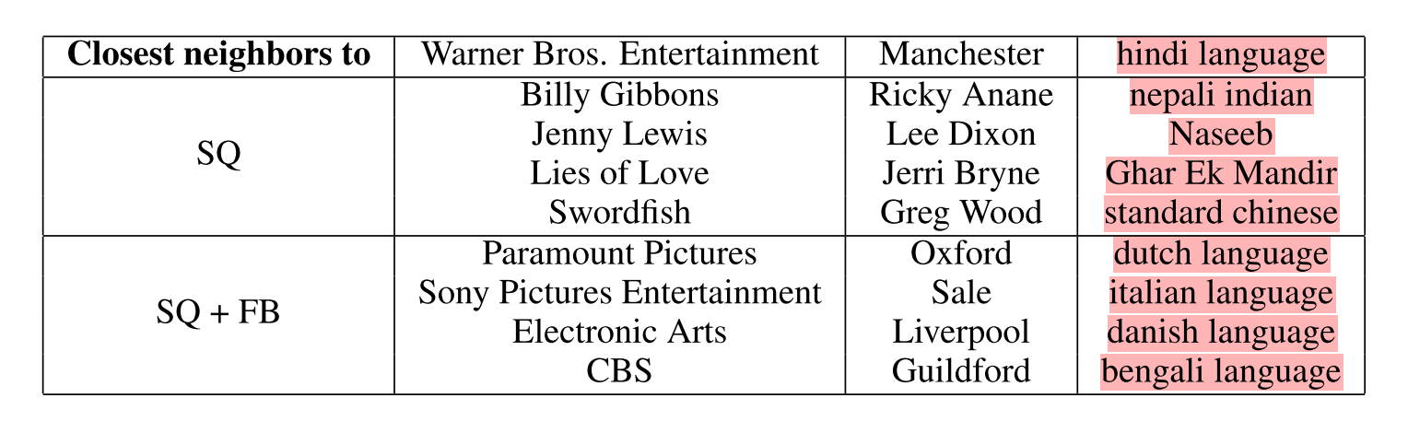
Paper 1 based on sub task 1(3/5)
Deal with sparse KG
Copyright © Shenglei Huang 2018.3.6

Slide 29
Paper 1 based on sub task 1(3/5)
Deal with unseen subject
Borrow the idea of placeholder from [Luong et al. 2015] who used to deal with rare words in NMT.
Replace the subject in question with “placeholder”
Fact: | {fires_creek, contained_by, nantahala_national_forest}
GT Question: | Which forest is Fires Creek in?
Modified Question: | Which forest is <placeholder> in?
Copyright © Shenglei Huang 2018.3.6
Notes:
It sounds like seq2seq model is learning templates.

Slide 30
Paper 1 based on sub task 1(3/5)
Unsolved Questions
How to deal with unseen relationships?
How to deal with unseen subject type?
Hady ElSahar, Christophe Gravier, Frédérique Laforest: Zero-Shot Question Generation from Knowledge Graphs for Unseen Predicates and Entity Types. NAACL (2018)
Copyright © Shenglei Huang 2018.3.6

Slide 31
Paper 1 based on sub task 1(3/5)
Part of Results
bayuvi dupki –contained by– europe | where is bayuvi dupki? | what continent is bayuvi dupki in?
Illinois –contains– ludlow township | what is the name of a place within illinois? | what is in illinois?
neo contra –publisher– konami | who is the publisher for the computer videogame neo contra? | who published neo contra?
pop music –artists– nikki flore | what artist is known for pop music? | who’s an american singer that plays pop music?
Copyright © Shenglei Huang 2018.3.6

Slide 32
Paper 1 based on sub task 1(3/5)
Part of Results
bayuvi dupki –contained by– europe | where is bayuvi dupki? | what continent is bayuvi dupki in?
Illinois –contains– ludlow township | what is the name of a place within illinois? | what is in illinois?
neo contra –publisher– konami | who is the publisher for the computer videogame neo contra? | who published neo contra?
pop music –artists– nikki flore | what artist is known for pop music? | who’s an american singer that plays pop music?
Copyright © Shenglei Huang 2018.3.6

Slide 33
Paper 2 based on sub task 2(4/5)
Learning to Ask: Neural Question Generation for Reading Comprehension
Xinya Du, Junru Shao, Claire Cardie
ACL 2017
Copyright © Shenglei Huang 2018.3.6

Slide 34
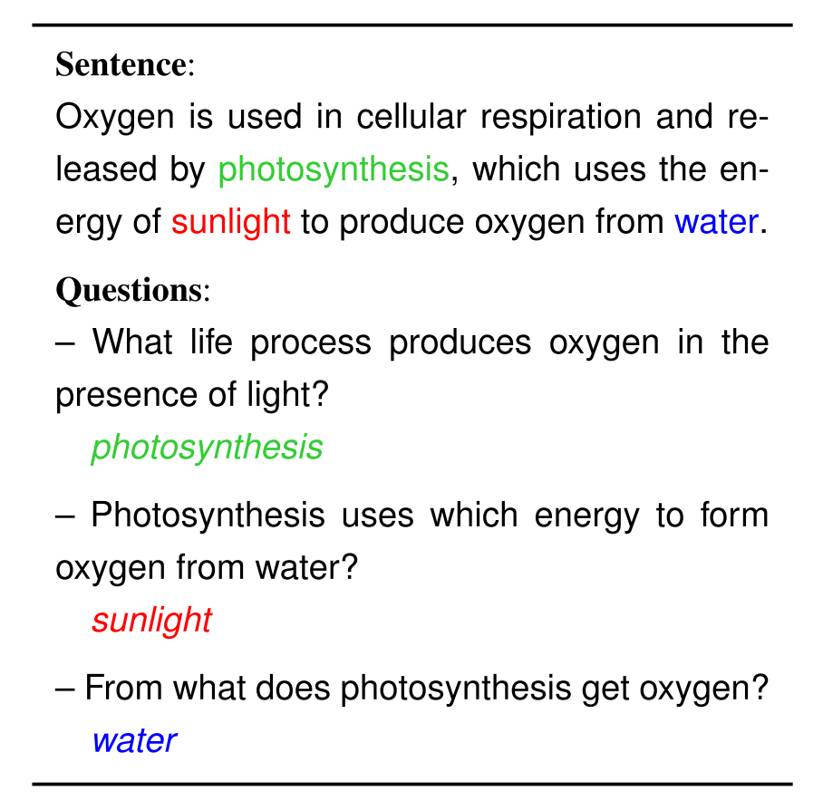
Paper 2 based on sub task 2(4/5)
Input: Single sentence
Output: Single question
Copyright © Shenglei Huang 2018.3.6

Slide 35
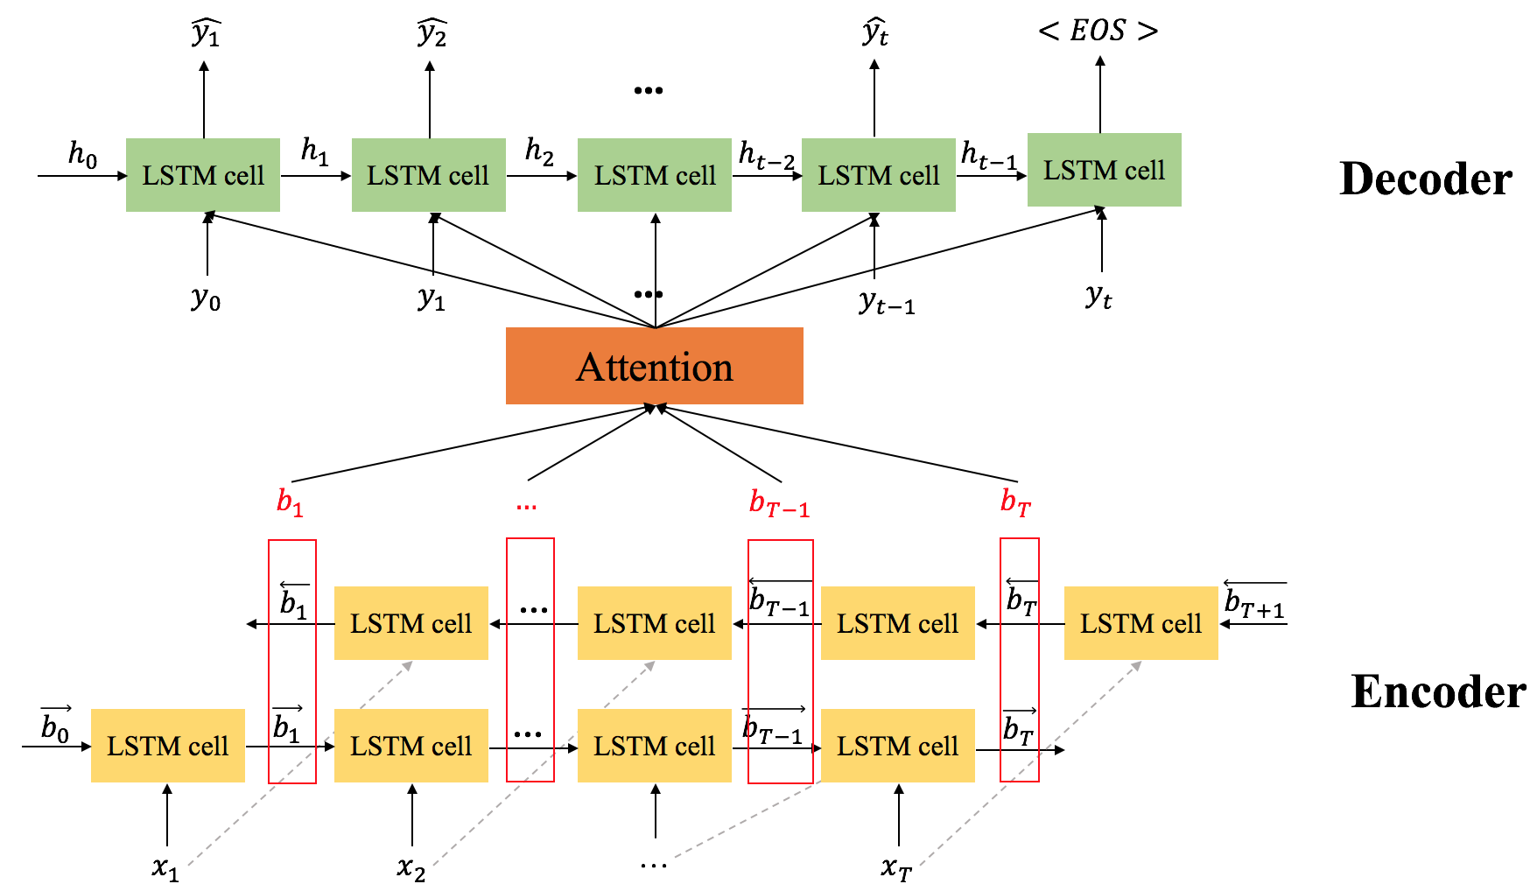
Paper 2 based on sub task 2(4/5)
Model Architecture
Copyright © Shenglei Huang 2018.3.6

Slide 36
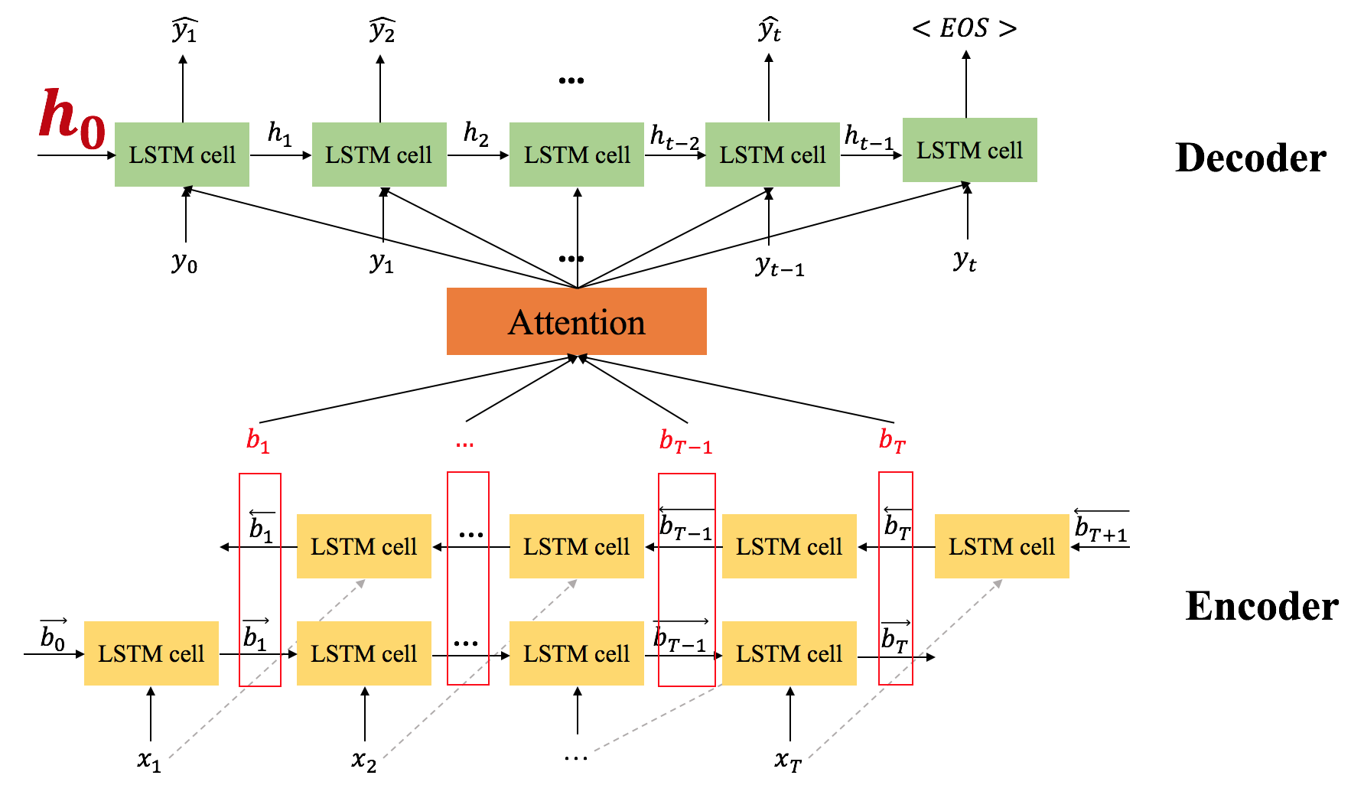
Paper 2 based on sub task 2(4/5)
Model Architecture
Copyright © Shenglei Huang 2018.3.6

Slide 37

Paper 2 based on sub task 2(4/5)
Model Architecture
$$[\vec{b_{1}};\overset{⃖}{b_{T}}]$$
Copyright © Shenglei Huang 2018.3.6

Slide 38
Paper 2 based on sub task 2(4/5)
Implementation Details
Dataset: SQuAD (paragraph, questions)
Extract paired sentences and questions from each data item.
Testing: beam search
Copyright © Shenglei Huang 2018.3.6

Slide 39
Paper 2 based on sub task 2(4/5)
Results
Sentence: the largest of these is the eldon square shopping centre , one of the largest city centre shopping complexes in the uk.
GT question: what is one of the largest city center shopping complexes in the uk?
Generated question: what is one of the largest city centers in the uk?
Sentence: free oxygen first appeared in significant quantities during the paleoproterozoic eon -lrb- between 3.0 and 2.3 billion years ago -rrb-.
GT question: during which eon did free oxygen begin appearing in quantity?
Generated question: how long ago did the paleoproterozoic exhibit?
Copyright © Shenglei Huang 2018.3.6

Slide 40
Conclusion(5/5)
Conclusions
1. There are two sub tasks in question generation, one for triples to question and the other for sentence to question.
2. There are no approaches that could generate question from sentences by referring to knowledge base.
What life process produces oxygen in the presence of light?
Photosynthesis
what continent is bayuvi dupki in?
Europe
Copyright © Shenglei Huang 2018.3.6

Slide 41
Thank you ☺

Slide 42



Question
Which
forest
…
?
GRU Decoder
Attention Mechanism
$$c_{1}$$
$$c_{…}$$
$$c_{T}$$
Fact embedding
Which
forest
…
Encoded
embeddings
TransE
embeddings
KB triples
fires_creek
(subject)
contained_by
(relationship)
nantahala_national_forest
(object)

Slide 43
Question
Which
forest
…
?
Decoder
$$c_{1}$$
$$c_{…}$$
$$c_{T}$$
Which
forest
…
Encoder
KB triples
fires_creek
(subject)
contained_by
(relationship)
nantahala_national_forest
(object)

Slide 44




























$$\hat{y_{1}}$$
$$\hat{y_{2}}$$
$$\hat{y_{t}}$$
$$<EOS>$$
...
$$h_{0}$$
LSTM cell
$$h_{1}$$
LSTM cell
$$h_{2}$$
LSTM cell
$$h_{t−2}$$
LSTM cell
$$h_{t−1}$$
LSTM cell
Decoder
...
$$y_{0}$$
$$y_{1}$$
$$y_{t−1}$$
$$y_{t}$$
Attention
$$b_{1}$$
$$…$$
$$b_{T−1}$$
$$b_{T}$$
$$\overset{⃖}{b_{1}}$$
LSTM cell
…
LSTM cell
$$\overset{⃖}{b_{T−1}}$$
LSTM cell
$$\overset{⃖}{b_{T}}$$
LSTM cell
$$\overset{⃖}{b_{T+1}}$$
Encoder
$$\vec{b_{0}}$$
LSTM cell
$$\vec{b_{1}}$$
LSTM cell
…
LSTM cell
$$\vec{b_{T−1}}$$
LSTM cell
$$\vec{b_{T}}$$
$$x_{1}$$
$$x_{2}$$
…
$$x_{T}$$

